Slide 1
NHS hackathon challenge 2 - Using weight loss Drug prescriptions to predict orthopaedic demand
Hackathon Team –
Bryan Crosland, Gemma Russell, Michael Thomas, Matthew Smith, Jennifer Grant, Rajendra Kadel, David Hutchings, Rhys Craig. Amirhossein Ghadiri

Slide 2
Challenge: using weight loss Drug prescriptions to predict orthopaedic demand
With the increasing use of GLP-1 drugs, there is interest in the likely knock-on impact on orthopaedics activity:
1) Reducing a person's weight can positively impact their joints; i.e. reduce the likelihood of them needing an orthopaedic referral
2) For those already with joint problems, reducing weight can improve a patient's likelihood of being accepted for surgery; i.e. increase the demand on orthopaedics.
This challenge is about exploring the relationship observable in the NHS Wales publicly available prescriptions data and orthopaedic activity. This can be done by exploring the literature evidence and relationships observed in public domain data.
Notes:
GLP 1 is according Gov.uk (2026) a weight loss medication which mimics the natural hormone which is released after eating that makes that makes you feel fuller as a result .

Slide 3
Approach taken
Review literature to identify relationship between weight loss drugs and orthopaedic demand
Collate and visualise trends in publicly available data:
Weight loss prescription data
Orthopaedics referral data
Obesity levels data
Not fitness for surgery data
Identify gaps in data publicly available
Develop method to identify relationship between weight loss drug prescriptions and orthopaedic demand
Develop model to split this into three parts:
identify relationship between obesity levels and orthopaedic demand (by speciality/health board)
forecast impact of weight loss drugs on obesity levels
assess increased demand based on fitness for surgery

Slide 4
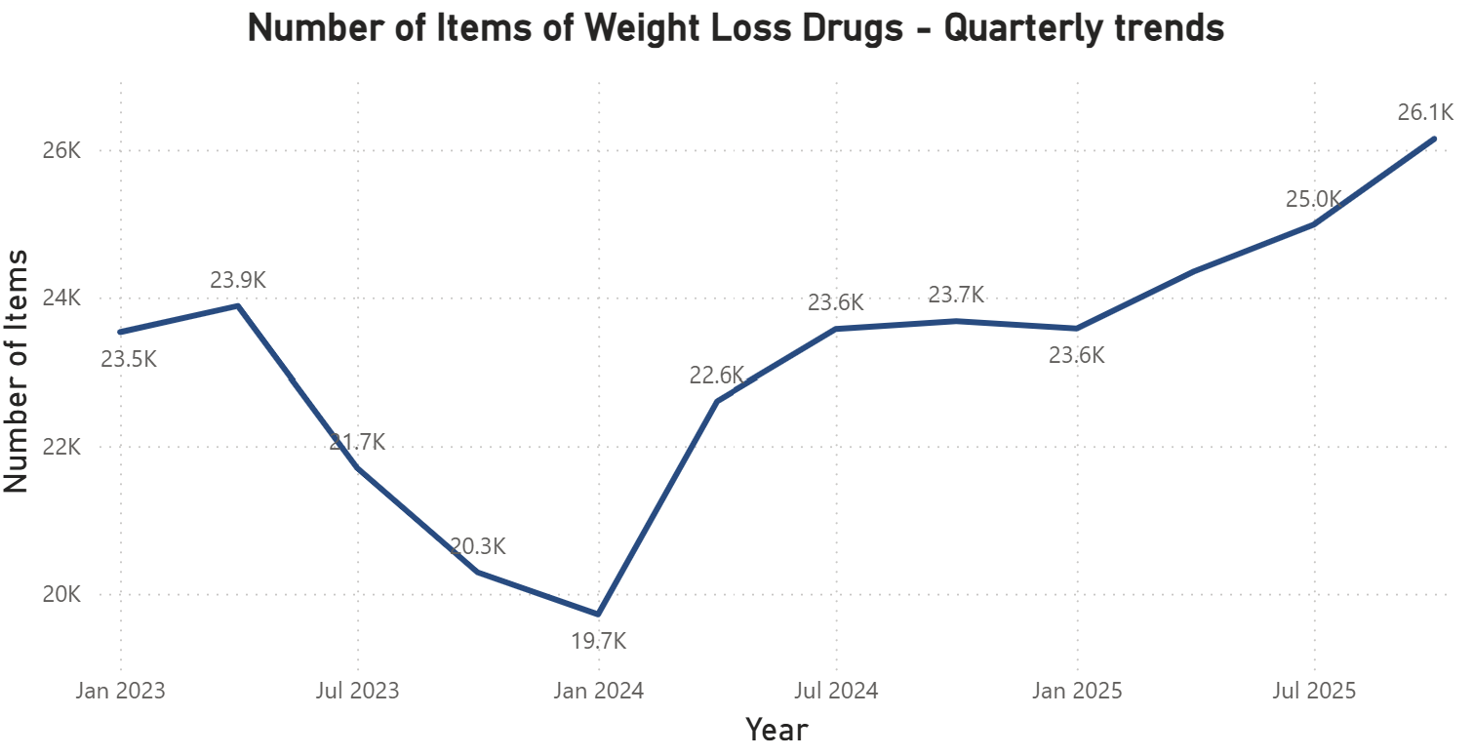
Exploratory Analysis – weight loss prescriptions
Process developed to collate and visualise historic weight loss drug prescriptions data from the General Practice Prescribing Data Extract
Additional information added on to map data back to health board level
Prototype dashboard created to analyse trends for different weight loss drugs and differences across health boards
Findings:
Recent increasing trend after a decline in prescriptions through 2023
Prescriptions by drug name and health board analysed to understand drivers of trend

Slide 5
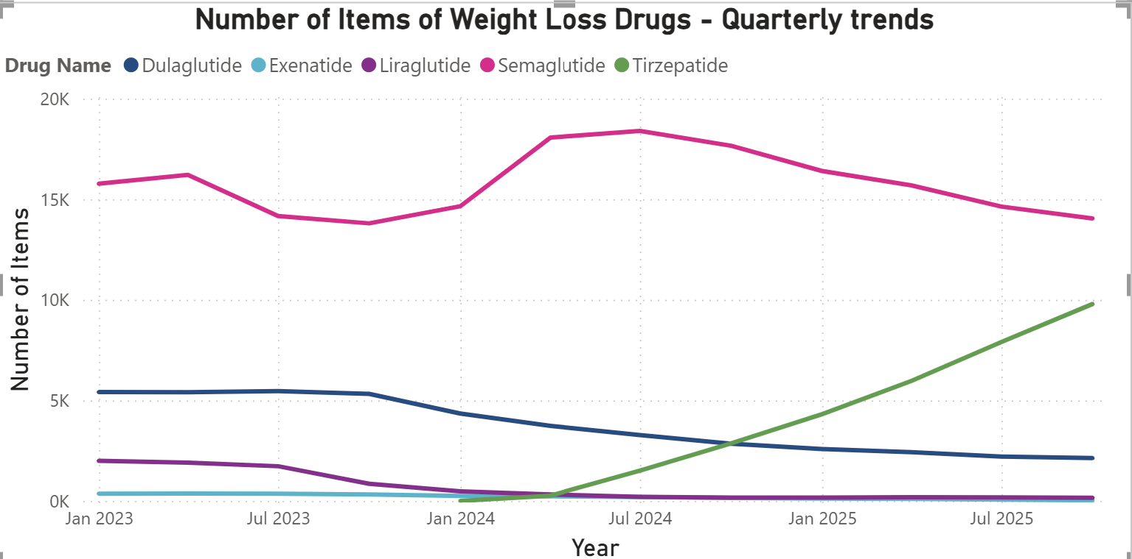
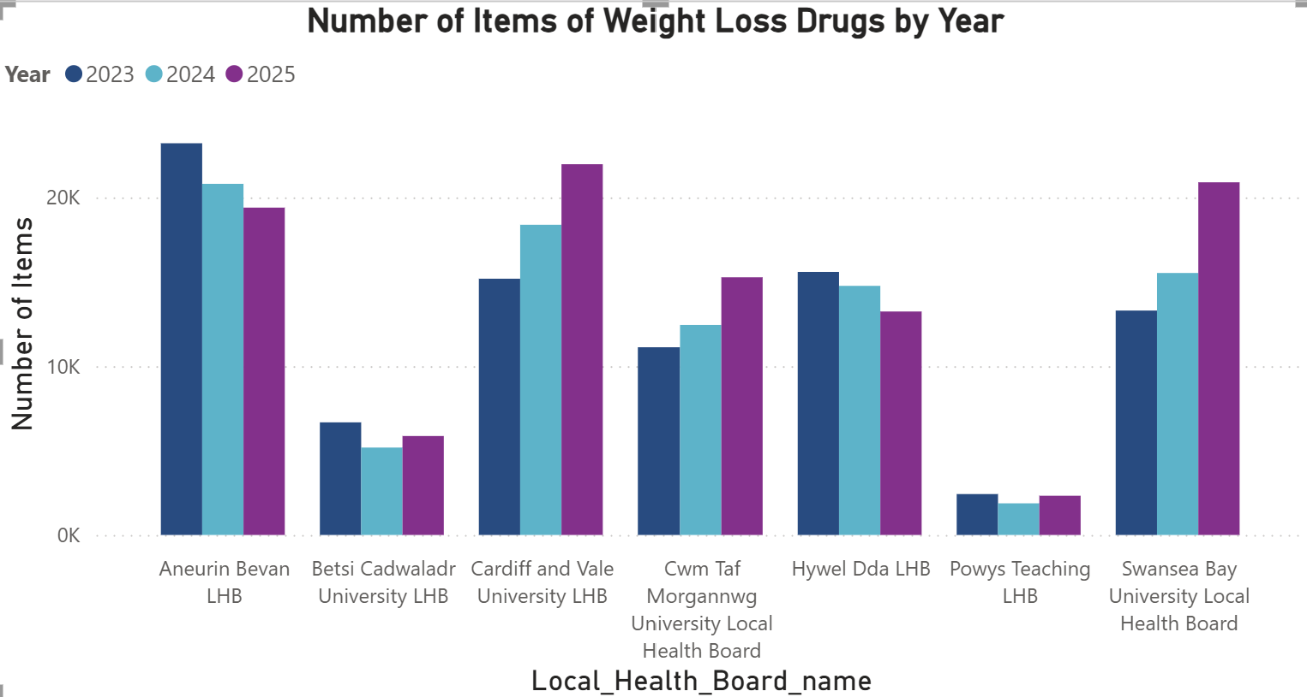
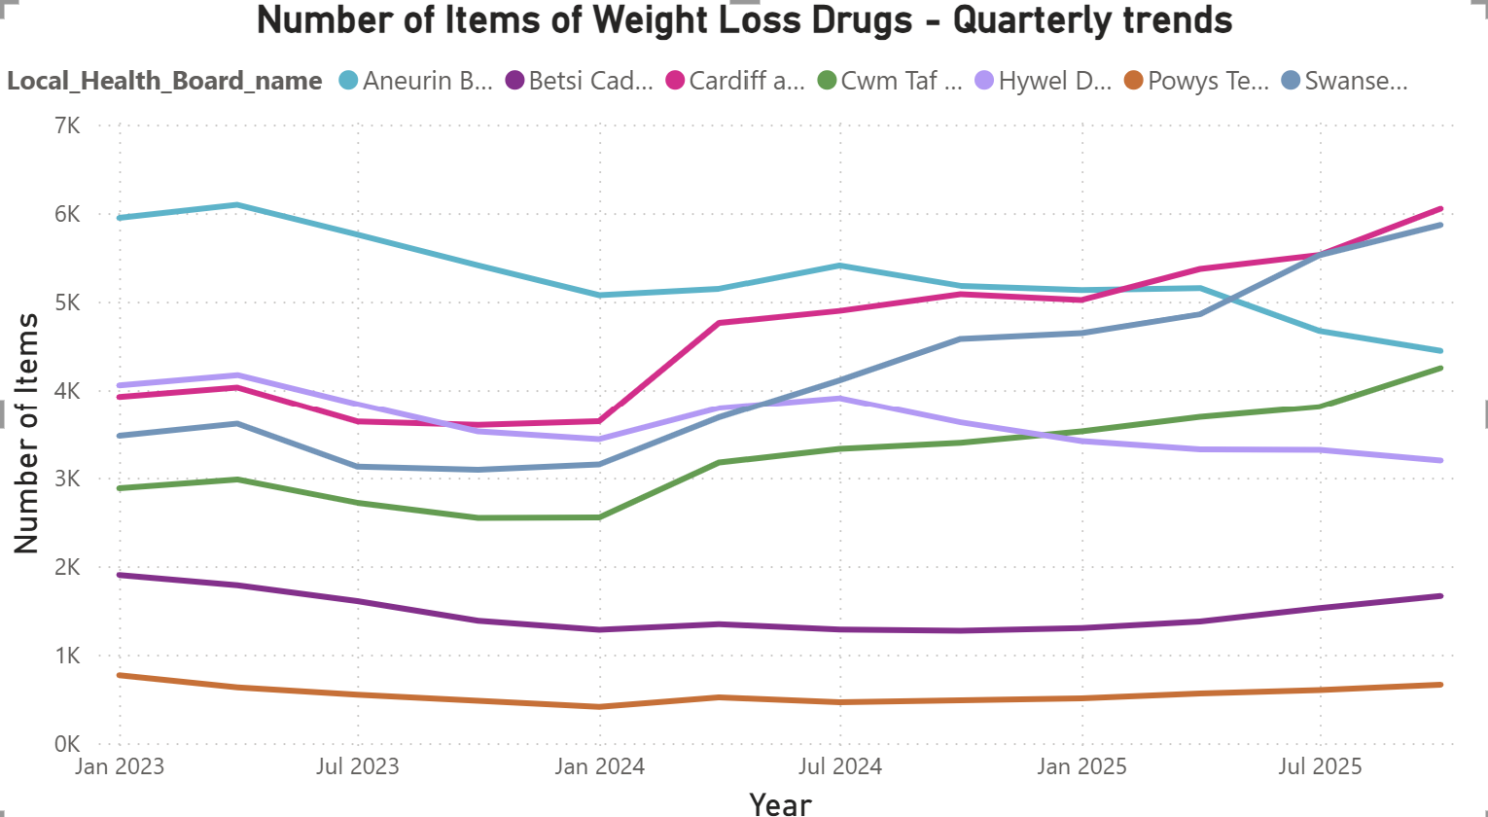
Exploratory Analysis – weight loss prescriptions
Findings:
Recent increase driven by Tirzepatide prescriptions (brand name: Mounjaro)
Swansea Bay, Cardiff and Vale, Cwm Taf increasing prescription levels but declining trend in Aneurin Bevan and Hywel Dda

Slide 6
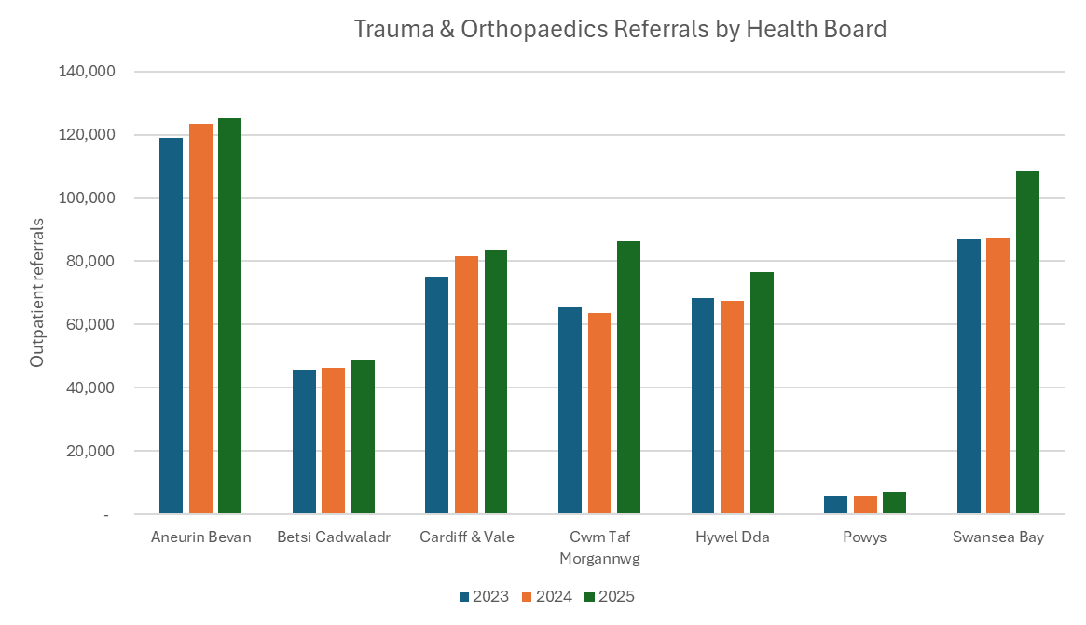
Exploratory Analysis – Orthopaedics referrals
Outpatient referrals data by health board sourced from StatsWales here: Outpatient referrals, April 2012 onwards | StatsWales
Filtered on speciality ‘Trauma & Orthopaedics’ for past 3 years to compare with weight loss prescription trends
No further breakdown available beneath this – ideally could filter this by GP cluster and to capture referrals with known links to obesity levels
Findings:
Overall ‘Trauma & Orthopaedics’ referrals increased by 15% in 2025 compared to 2023
All health boards have seen an increase with Cwm Taf, Swansea Bay and Hywel Dda seeing the largest increases during 2025
Notes:
- Download outpatient referrals file: 'outpatient-referrals-april-2012-onwards-v7-en-gb.csv' extracted from https://stats.gov.wales/en-GB/9e8f6f1d-d4aa-457a-a675-cc0e2caef3a5/ with no filters applied to bring through all specialities
- Filter referrals data to 'all referrals' col 'Source of referral', 'exclude Wales' col 'Local health board provider',
exclude 'all specialities', 'paediatrics' specialties col 'Specialty'
- Filter timeframe to match gp prescription availability col 'Date_reference'
- Copy filtered data into new file: 'Referrals_Prescriptions.xlsx'

Slide 7
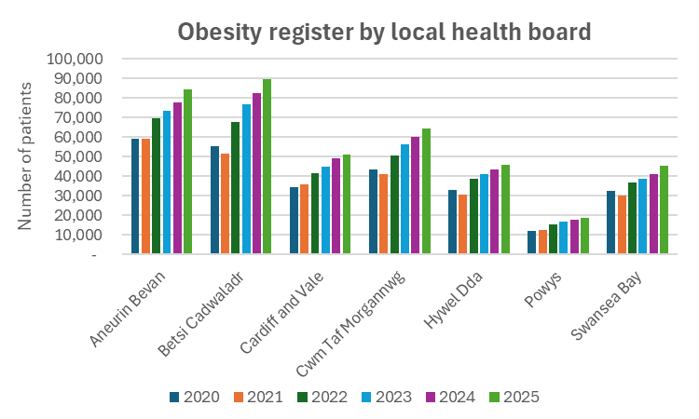
Exploratory Analysis – obesity levels
Disease registers by local health board, cluster and GP practice: Population registered at each GP practice and population registered with various diseases, including obesity. (https://stats.gov.wales/en-GB/da26395b-945e-4fad-b886-00cbb565a14a/)
Gives a snapshot of how many patients are on the register in a calendar year, with some years September has been used with more recent years it is taken in April
Filtered on register ‘Obesity (patients aged 16+) ’ for past 6 years to look at recent trends
Findings:
All health boards had an increase in patients on the obesity register over past 6 yrs
400,000 patients currently on register across Wales so potential for weight loss drug prescriptions to increase from current levels depending on any changes to guidance
Other factors behind increase in obesity levels and any other interventions planned need exploring
Notes:
(1st Apr 2025 snapshot)
Current monthly levels of prescriptions are under 10,000.

Slide 8
Exploratory Analysis – Not Fit for surgery
No publicly available data found
Guidance highlighted ….
Findings:
tbc

Slide 9
Identify gaps in publicly available data
Outpatient referrals data filtered and broken down to those associated with obesity and at GP cluster level
Understanding of what referrals could be impacted by reduced obesity levels
More detailed information around patients on obesity register to understand how many could be suitable for weight loss drugs in the future if there are any changes to the guidance of their use
No publicly available not fit for surgery data

Slide 10
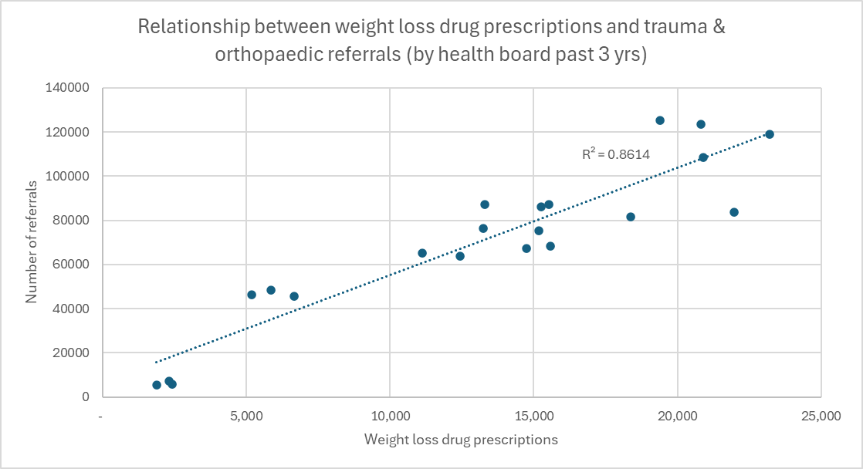
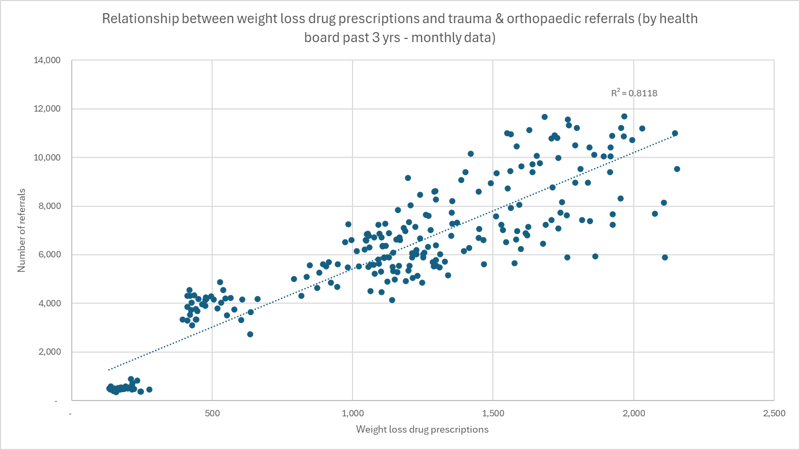
method to identify relationship between weight loss drug prescriptions and orthopaedic demand
Compared the annual number of outpatient referrals for ‘Trauma & Orthopaedics’ against the annual number of weight loss drug prescriptions using a scatter plot
Repeated this comparison using monthly data available from both datasets
Findings:
There is a correlation between the number of weight loss drug prescriptions and the number of orthopaedic referrals when comparing these figures at health board levels over the past 3 years
With the number of referrals increasing as the number of prescriptions gets higher

Slide 11
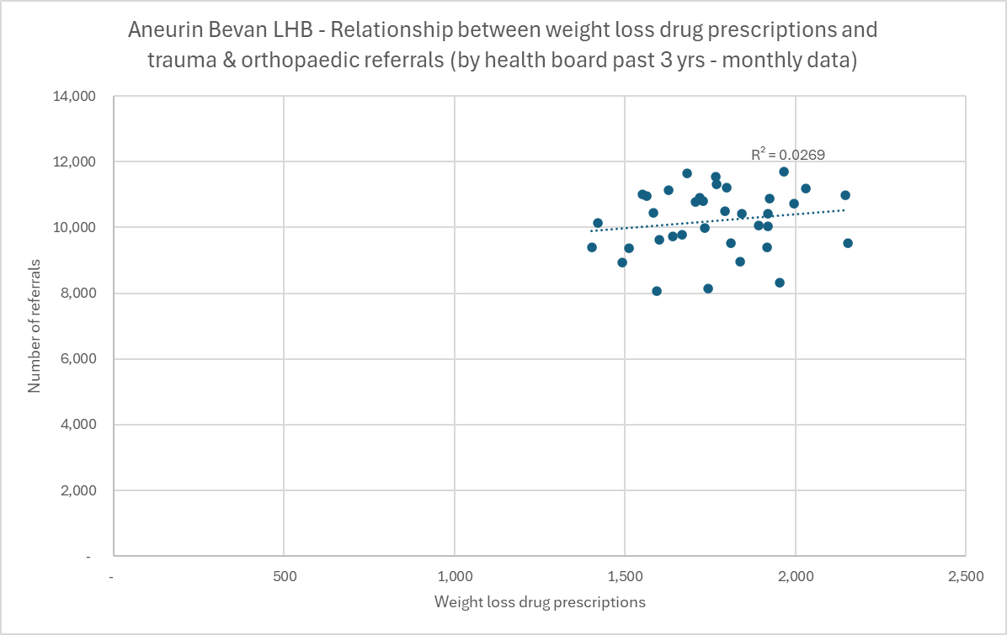
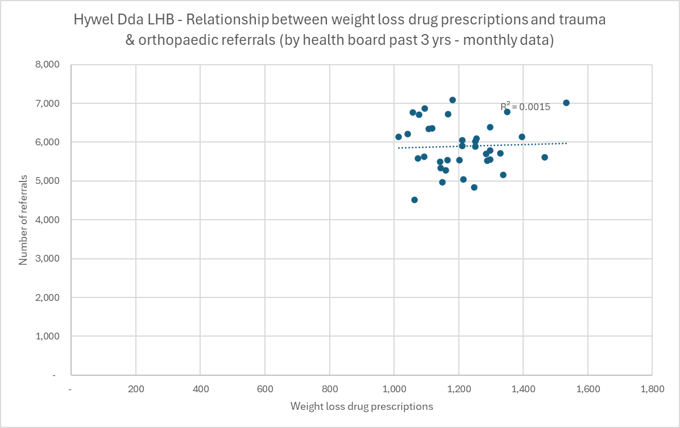
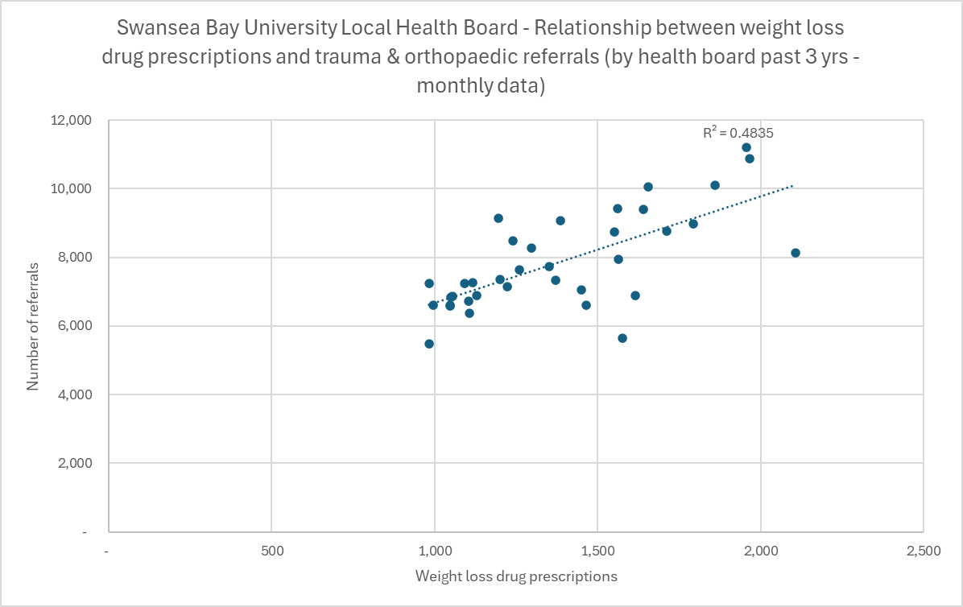
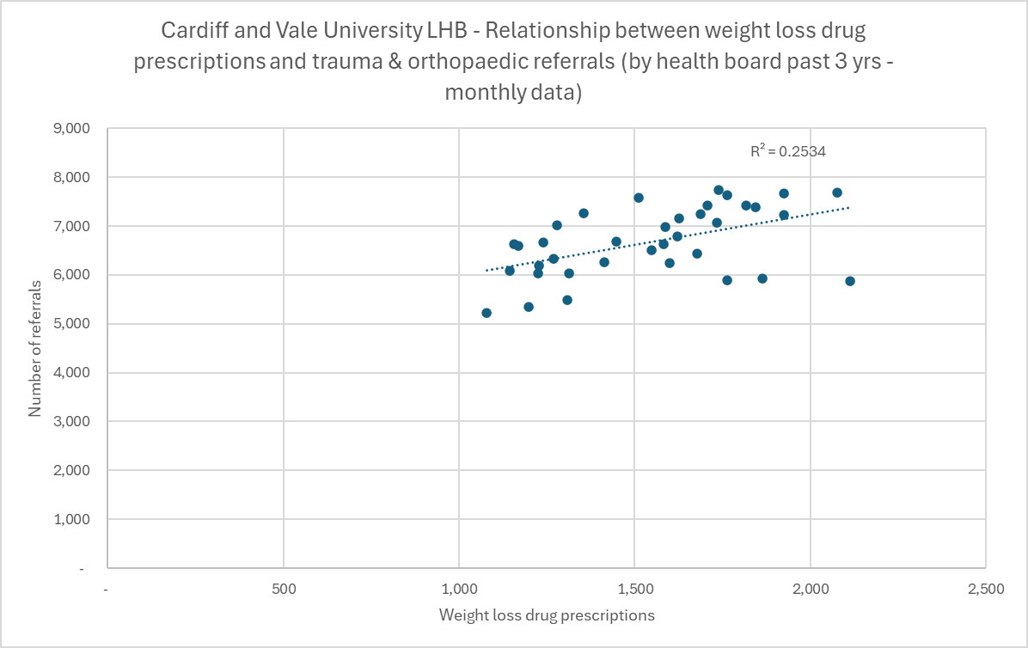
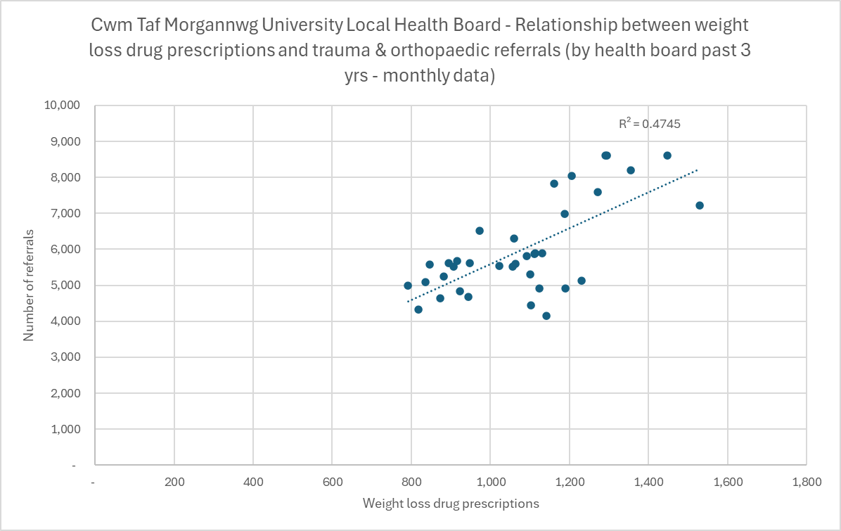
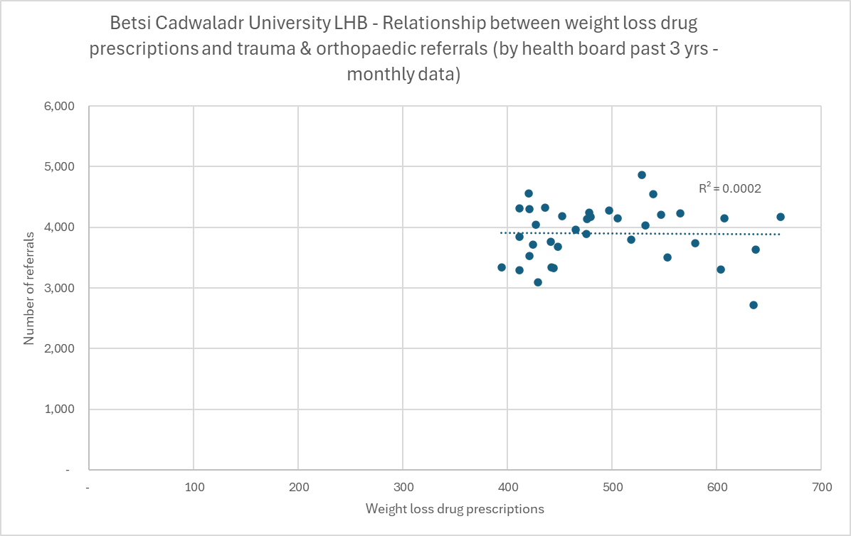
method to identify relationship between weight loss drug prescriptions and orthopaedic demand
Monthly prescriptions were then correlated to referrals for individual health boards
Findings:
This highlighted no relationships for some health boards with others showing some level of positive correlation
Swansea Bay and Cwm Taf both had a correlation of 0.69, Cardiff and Vale 0.5
The other 4 health boards had correlations less than 0.21 indicating limited correlation
The health boards with the largest increase in prescriptions had the strongest correlation

Slide 12
method to identify relationship between weight loss drug prescriptions and orthopaedic demand
To help put these results into context the top 15 outpatient referral categories (account for over 80% referrals) were correlated against the prescription data
Findings:
This showed that the prescriptions had the highest correlation with ‘Trauma & Orthopaedics’ speciality
When this was repeated for individual health boards the strength of the correlation decreased
This approach could be repeated with more detailed orthopaedic referral categories to help better understand the relationship with prescriptions trends

Slide 13
Literature Review.
NHS hackathon challenge 2 -Using weight loss Drug prescriptions to predict orthopedic demand
GLP-1 Agonists and Orthopaedic Surgery: A Review of Their Impact on Bone Metabolism, Wound Healing
Literature review of GLP-1RAs and orthopaedic surgery which looks at GLP-1RAs potentially improving bone metabolism, wound healing and surgical outcomes (e.g. reduction in post-surgery infection prevalence and reduction in readmissions).
Glucagon-Like Peptide-1 Agonists in Total Hip Arthroplasty
This research paper conducted a study about patient being prescribed GPL 1 medications whilst having their surgical procedure and has compared this with patient who were not prescribed GPL1 medications. The Sample size of this study was small and the GLP 1 cohort experienced nausea and vomiting the study shows that would require a larger sample size for further investigation.
Glucagon-Like Peptide Receptor-1 Agonists Used for Medically-Supervised Weight Loss in Patients With Hip and Knee Osteoarthritis: Critical Considerations for the Arthroplasty Surgeon
This is a study that focussed on the supervised weight loss of patients through clinical trials of GLP 1 medications and found that Liraglutide had a weight loss percentage at 56 weeks on liraglutide 3.0mg 8.0% . The study also list other GLP 1 medications trails and the associated results. The study also mentioned other health benefits of the GLP 1 medications being : lower risk of Mortality, lower blood sugar levels, lower risk of stroke as well as other benefits. The study also highlighted the side effects of the medications and the risks.

Slide 14
Further work / Day 2 tasks
NHS hackathon challenge 2 -Using weight loss Drug prescriptions to predict orthopedic demand
Continue literature review and sumarise findings linking back to identifying relationships with obesity and orthopaedics and also impact of weight loss drugs
Validate findings included in updated presentation and critique / improve approach taken
Source not fit for surgery data / guidance
Attempt to create template model of orthopaedic demand taking into account reduction in demand due to reduced obesity levels and additional demand due to increased eligibility for surgery
Source more granular level data to:
identify relationship between weight loss drugs and obesity levels including time lags
identify relationship between obesity levels and orthopaedic demand - by health board and orthopaedic referral reason
identify current patient cohort not fit for surgery due to weight to assess supressed orthopaedic demand

